Slide 1
RMI
Software Engineering - cs3013
Onut Iosif-Viorel

Slide 2
RMI
Content
Theory
Example

Slide 3
RMI
Introduction
Goals
  develop distributed Java programs
Tasks
  single JavaTM Virtual Machine → multiple

Slide 4
RMI
Distributed vs. Non-distributed Java Programs
Object Definition
defined by a Java class | defined by an interface that must extend the Remote interface.
Object Implementation
implemented by its Java class | Implemented by a Java class that implements the remote interface
Object Creation
new operator | is created on the host computer with the java.rmi.Naming.lookup.
Exceptions
The Java compiler forces a program to handle all Exceptions | RMI forces programs to deal with any possible RemoteExceptions

Slide 5

RMI Architecture
Interfaces
Uses interfaces
classes define implementation
Principle
JVM
JVM
clients are concerned about the definition of a service
servers are focused
on providing the service
Network

Slide 6
RMI Architecture
Interfaces
Uses interfaces
classes define implementation
Principle
JVM
JVM
INTERFACE
IMPLEMENTATION
Network
RMI system

Slide 7
RMI Architecture
Interfaces
! two classes that implement
the same interface.
The actual implementation
Acts Like
a Proxy Object
JVM
JVM
Implements
INTERFACE
IMPLEMENTATION
Implements
IMPLEMENTATION_Stub
Network
RMI system

Slide 8
RMI Architecture
Interfaces
Server
The actual implementation
Client
Acts Like
a Proxy Object
JVM
JVM
Implements
INTERFACE
IMPLEMENTATION
Implements
IMPLEMENTATION_Stub
Network
RMI system

Slide 9
RMI Architecture
Architecture Layers
Server
intercepts method calls
redirects these calls to a remote RMI service.
The actual implementation
Client
Acts Like
a Proxy Object
JVM
JVM
Implements
INTERFACE
IMPLEMENTATION
Implements
Stub
IMPLEMENTATION_Stub
Network
RMI system

Slide 10
RMI Setup
Client-Server connection
Server
The actual implementation
Client
How does the client finds
the remote service ?
JVM
JVM
INTERFACE
IMPLEMENTATION
Creates a remote service
1. Create the local object that implements the interface
2. Exports that object to RMI
URL that specifies :
rmi://<host_name>
[:<name_service_port>]
/<service_name>
URL that specifies :
rmi://<host_name>
[:<name_service_port>]
/<service_name>
ServerInterface serverObj;
serverObj =(ServerInterface)Naming.
lookup("//localhost/ServerInterface");
ServerInterface obj =new ServerInterfaceImpl();
Naming.rebind("//localhost/ServerInterface",obj);
Default: port 1099

Slide 11
RMI
Content
Theory
Example
  ICE 6 Lottery System
    ICERetailer
    ICEServer
    Ticket
  Scenario
    Create Ticket → ICE Retailer
    Generate Ticket ID → ICE Server
    Store Ticket Information → ICE Server
    Display Ticket Information → ICE Retailer

Slide 12

RMI – ICE 6 Example
Goal
      retailer ID
      draw NO
      sale Date
      sale Time
      Line 1 + Line 2
      ! NO Price !
      Send to Server
ICEServer
Server
ICERetailer

Client
JVM
JVM
      Ticket ID
      Store Ticket
      Send to Retailer
      Display Ticket
      Print Ticket

Slide 13
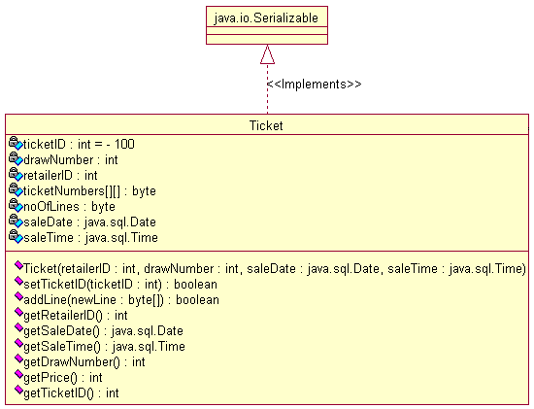
RMI – ICE 6 Example
Ticket
      retailer ID
      draw NO
      sale Date
      sale Time
      Line 1 + Line 2
      ! NO Price !
      Send to Server
ICEServer
ICERetailer

JVM
JVM
      Ticket ID
      Store Ticket
      Send to Retailer
      Display Ticket
      Print Ticket

Slide 14
RMI – ICE 6 Example
      retailer ID
      draw NO
      sale Date
      sale Time
      Line 1 + Line 2
Ticket
      Ticket ID

Slide 15
RMI – ICE 6 Example
      draw NO
      retailer ID
      Line 1..5
      sale Date
      sale Time
Ticket
      Ticket ID

Slide 16
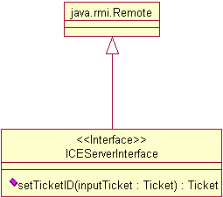
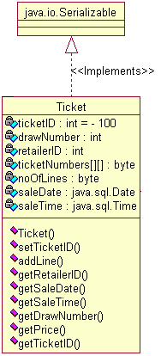
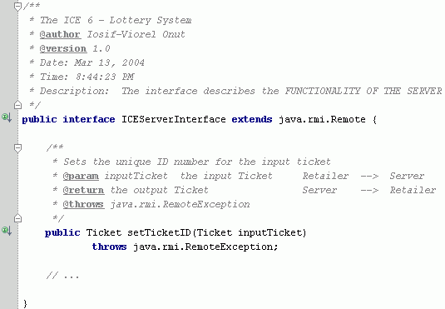
RMI – ICE 6 Example
?
Client-Server
ICERetailer
ICEServer
      Create Ticket
        retailer ID
        draw NO
        sale Date
        sale Time
        Line 1 + Line 2
      Set Ticket ID
      Send it to Server
      Send it to Retailer

Slide 17
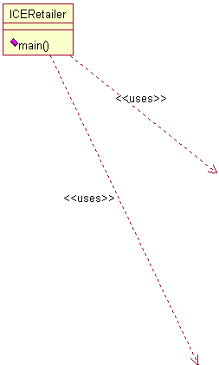
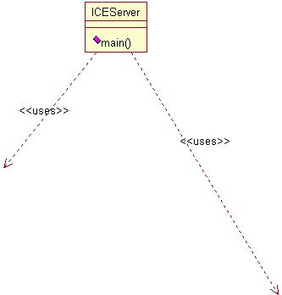
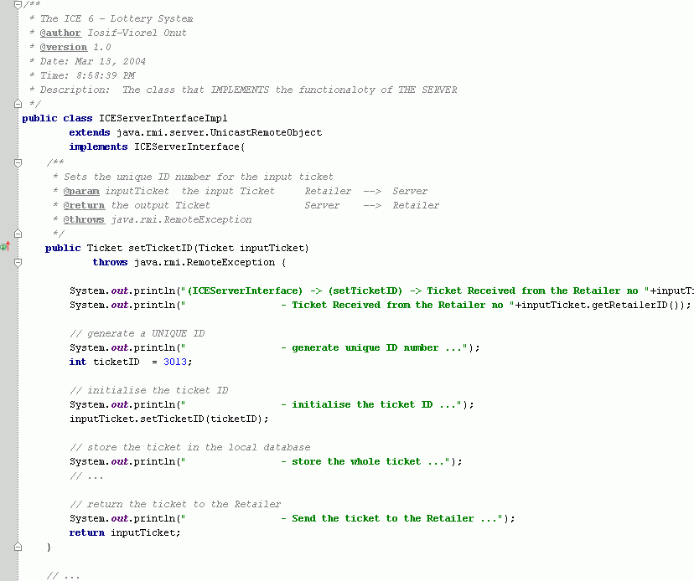
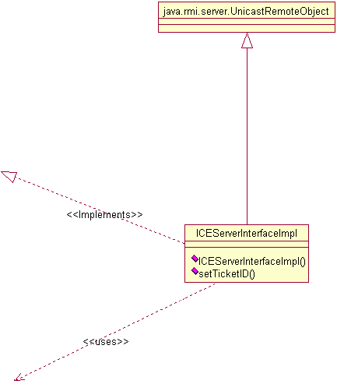
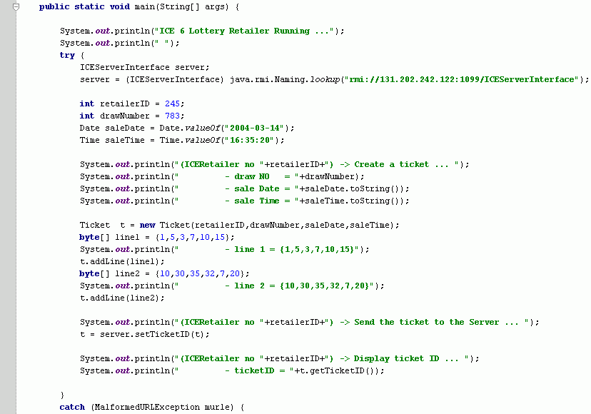
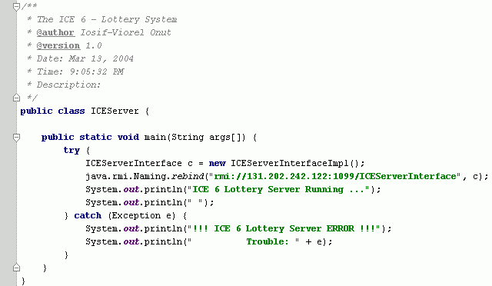
RMI – ICE 6 Example
Client-Server
out
in
ICERetailer
ICEServer
      Create Ticket
        retailer ID
        draw NO
        sale Date
        sale Time
        Line 1 + Line 2
      Set Ticket ID
      Send it to Server
      Send it to Retailer

Slide 18
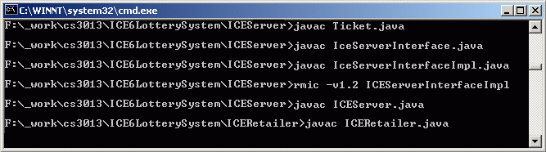
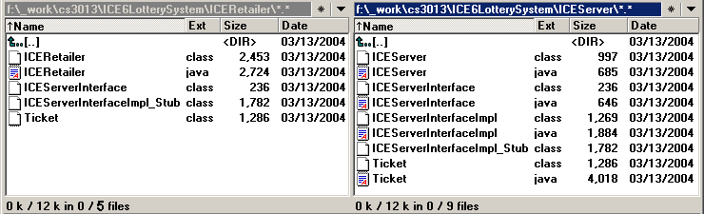
RMI – ICE 6 Example
Client-Server
ICERetailer
ICEServer
COPY
COPY
      Ticket.class
      Ticket.java +.class
      ICEServerInterface.java +.class
      ICEServerInterfaceImpl.java +.class
      ICEServer.java +.class
      ICEServerInterface.class
COPY
      ICEServerInterfaceImpl_Stub.class
      ICEServerInterfaceImpl_Stub.class
      ICERetailer.java + .class

Slide 19
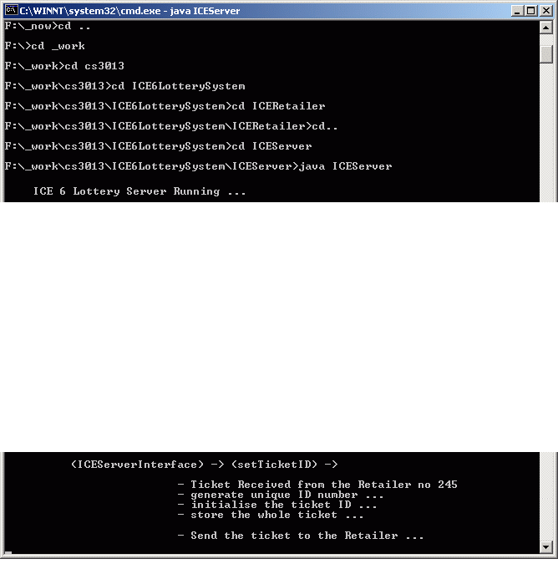
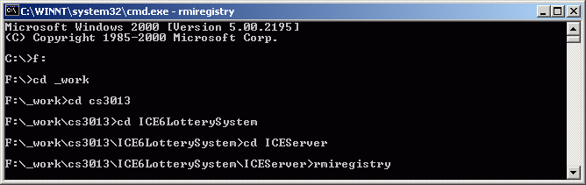
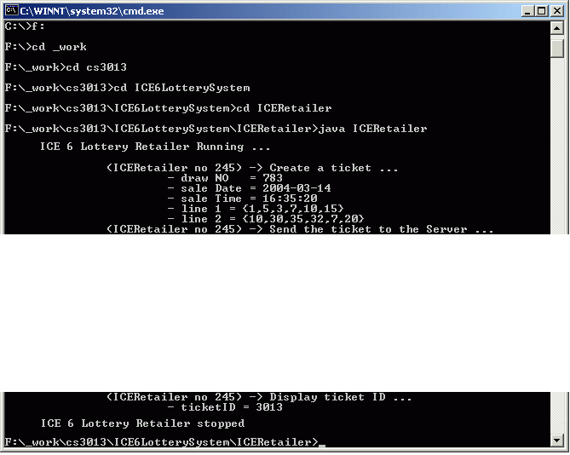
RMI – ICE 6 Example
Run …
ICERetailer
ICEServer

Slide 20
Thank You !
Questions ?
The .ppt
The Rational Rose - UML diagram
The Source Code

